Slide 1

AUTO GRADATION OF
HANDWRITTEN MATHEMATICAL ANSWER SHEETS
PHASE I
Minor Project
2020-21
Adamyaa D N (1RV18IS002)
Ananya G M (1RV18IS006)
Varshini P (1RVIS18058)
S. G. Raghavendra Prasad
Assistant Professor

Slide 2
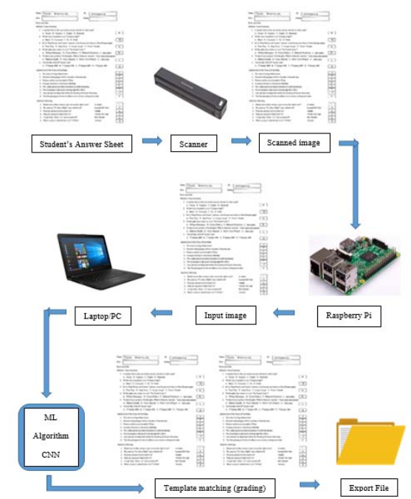
Automated Grading for Handwritten Answer Sheets using Convolutional Neural Networks
This paper proposes an automated system for grading handwritten answer sheets with the help of Convolutional Neural Networks (CNN).
A portable scanner is used to scan and store the student’s handwritten onto the Raspberry Pi where the scanned images are converted from pixmap to jpg format. The jpg formatted image is sent to a laptop/PC from the Raspberry Pi, wirelessly which contains the CNN models as well as the MATLAB Segmentation code. The python scoring code which loads the trained CNN model, outputs the score for each student.

Slide 3
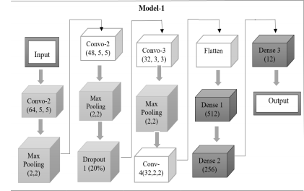
Dataset : The dataset was collected by disturbing the template to 250 students in Prince Mohammad Bin Fahd University. Each answer sheet consisted of 20 questions, therefore a total of 5080 segmented images was obtained for 250 answer sheets.
Results : Optimal test accuracy was achieved when the epoch size is equal to the batch size for both model 1 (92.866 %) and model 2 (92.3274 %). The result generated provided an enhanced basis for utilizing CNN architecture in the use of handwritten character recognition as a resolution to the challenges that are caused by traditional methods.
CNN Architecture for Model 1

Slide 4
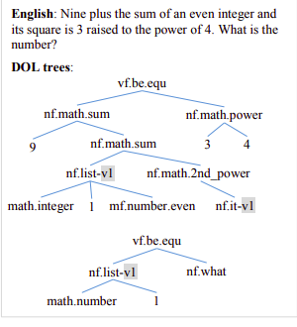
Automatically Solving Number Word Problems by Semantic Parsing and Reasoning
This paper presents a computer system called SigmaDolphin which automatically solves math word problems by semantic parsing and reasoning. We design a meaning representation language called DOL (abbreviation of dolphin language) as the structured semantic representation of NL text.
A semantic parser is implemented to transform math problem text into DOL trees. A reasoning module is included to derive math expressions from DOL trees and to calculate final answers.

Slide 5
Every meaningful piece of NL text is represented in DOL as a semantic tree of various node types such as constants, classes, functions, noun functions, pronoun functions etc.
DATASETS : The problem collection contains 1,878 math number word problems, collected from two web sites: algebra.com6 (a website for users to post math problems and get help from tutors) and answers.yahoo.com7 . Problems on both sites were organized into categories.
BASELINE METHODS : We compare our approach with two baselines: KAZB (Kushman et al., 2014) and BasicSim. KAZB is a learning-based statistical method which solves a problem by mapping it to one of the equation templates determined by the annotated equations in the training data. BasicSim is a simple statistical method which works by computing the similarities between a testing problem and those in the training set, and then applying the equations of the most similar problem.
RESULT : The approach achieves a particularly high precision of 95%. That means once an answer is provided by our approach, it has a very high probability of being correct.

Slide 6
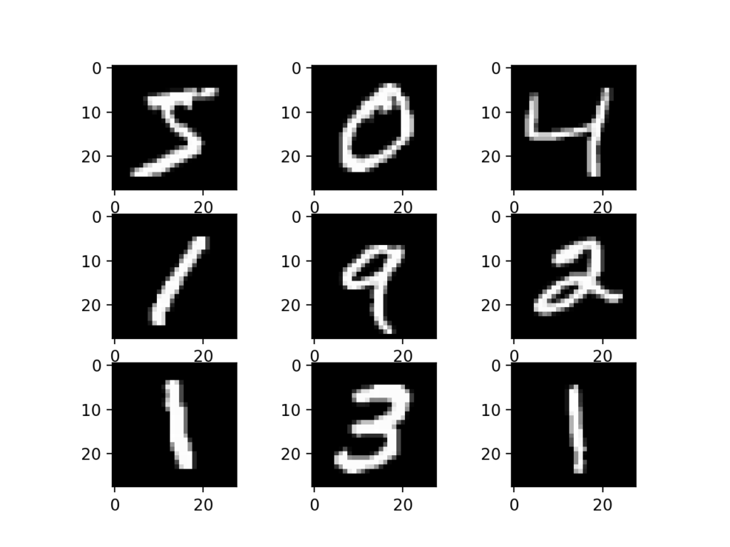
Deep Columnar Convolutional Neural Network
Methodology
Deep Convolutional Neural Networks is used.
Adadelta learning algorithm used as optimizer.
Works on MNIST dataset.
Architecture
Termed as Deep columnar convolutional neural networks (DCCNN)
Techniques used to train the network :
Wide Architecture
Deep Architecture
GPU Processing
MNIST Dataset

Slide 7
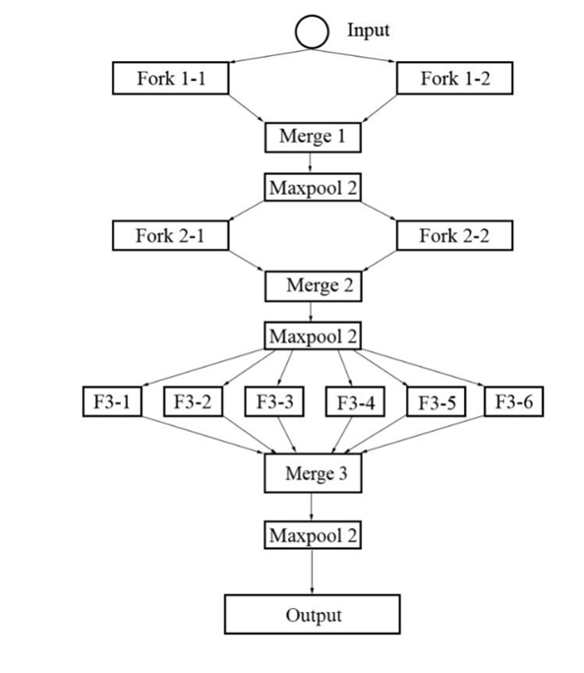
Pooling via Convolution Subsampling
Variable Kernel Size
Fork Layers
Merge Layers
Results
Method | Error Rate %
CNN | 0.4
MCDNN | 0.23
DCNN | 0.23
DCCNN architecture for MNIST dataset

Slide 8
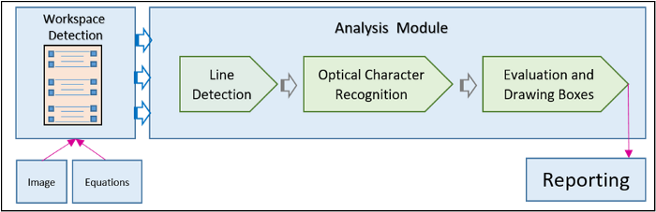
Autograding Handwritten Mathematical Answer Sheets

Slide 9
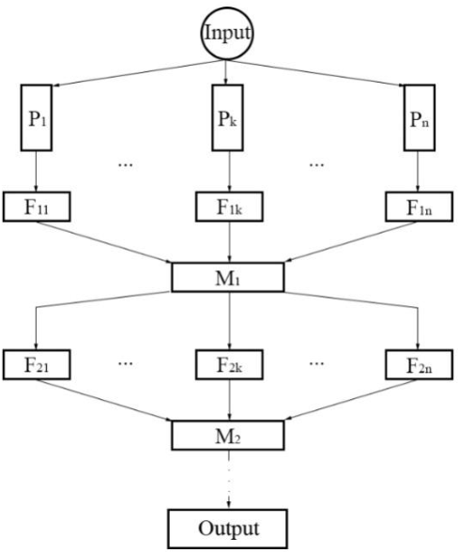
MNIST Dataset
Deep Columnar Convolutional Neural Network

Slide 10
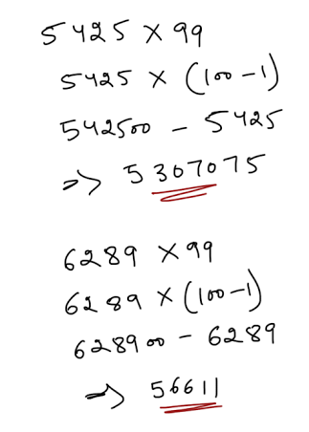
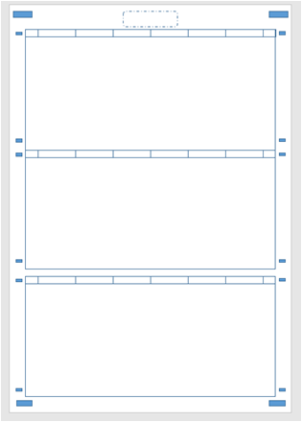
Workspace

